Slide 1
The Consumer Behavior and Shopping Habits: A Deep Dive into Customer Choices
Related Paper Study Presentation
Code Crushers - Group 05
Md. Baker
Fatema Akter Rimi
Syed Niamul Kazbe Rayian

Slide 2
Introduction
Paper 01 | Paper 02 | Paper 03
Name: Predictive modeling of consumer purchase behavior on social media: Integrating theory of planned behavior and machine learning for actionable insights | Name: Social Networks Marketing and Consumer Purchase Behavior: The Combination of SEM and Unsupervised Machine Learning Approaches | Name: Predicting User Behavior in e-Commerce Using Machine Learning
Author: Md. Shawmoon Azad, Shadman Sakib Khan, Rezwan Hossain, Raiyan Rahman, Sifat Momen | Author: Pejman Ebrahimi, Marjan Basirat, Ali Yousefi, Md. Nekmahmud, Abbas Gholampour and Maria Fekete-Farkas | Author: Rumen Ketipov, Vera Angelova, Lyubka Doukovska and Roman Schnalle
Published: December 27, 2023 On PLOS ONE Journal | Published: March 25, 2022 On MDPI Journal | Published: September 28, 2023 On SCIENDO Journal

Slide 3
Description
Paper 01 | Paper 02 | Paper 03
This article presents a novel approach that combines the theory of planned behaviour (TPB) with machine learning techniques to develop accurate predictive models for consumer purchase behaviour. This study examines three distinct factors of the theory of planned behaviour (attitude, social norm, and perceived behavioural control) that provide insights into the primary determinants influencing online purchasing behaviour. A total of eight machine learning algorithms, namely K-nearest neighbour, Decision Tree, Random Forest, Logistic Regression, Naive Bayes, Support Vector Machine, AdaBoost, and Gradient Boosting, were utilised in order to forecast consumer purchasing behaviour. Incorporated Explainable AI (XAI), specifically LIME (Local Interpretable Model-Agnostic Explanations), to elucidate how the best machine learning model (i.e. gradient boosting) makes its prediction. | This research tested five dimensions of social network marketing that are capable of influencing consumer purchase behaviour (CPB). This research was to examine the possible effect of entertainment, customization, interaction, word of mouth and trends on consumer purchase behaviour with evidence from the Facebook marketplace in Hungary. They uses the convenience sampling approach to overcome bias. The paper used the combination of structural equation modelling (SEM) and unsupervised machine learning (ML) approaches to cluster consumer behaviors. | This study explores the relationship between fundamental personality dimensions and users' online shopping styles, using the TIPI test as a tool to establish individual consumer profiles. Through the application of Machine Learning models like Decision Trees and Random Forest, the research successfully predicts consumer behavior in e-Commerce settings based on personality traits. The findings suggest that personalized user interfaces tailored to specific user groups can enhance customer experiences and drive business success in various industries, including Strategic Management, Marketing, and e-commerce. This user-centric approach, combining personality knowledge with predictive techniques, holds promise for improving decision-making processes and enhancing overall customer satisfaction in online retail environments.

Slide 4

Dataset
Paper 01 | Paper 02 | Paper 03 | Our Paper
Customer Information: ID, Gender, Age, Ethnic, Occupation, Annual Income, Social Media usage, Experience of purchasing due to social media influence, Reviews and rating impact on purchasing decision, Average time spent on the Internet (weekly), Attention to advertisement on social media Behavior Information: Purchase Behaviour 1 (PB1), Purchase Behaviour 2 (PB2), Purchase Behaviour 3 (PB3), Purchase Behaviour 4 (PB4), Attitude 1 (ATTD1), Attitude 2 (ATTD2), Attitude 3 (ATTD3), Attitude 4 (ATTD4), Social Norms 1 (SN1), Social Norms 2 (SN2), Social Norms 3 (SN3), Social Norms 4 (SN4) Dataset Collected From- https://data.mendeley.com/datasets/nzy5528nst/2 | Customer Information: Gender, Age, Education, Social Media usage Dataset is private. This research uses the convenience sampling approach of gathering data, out of 475 surveys distributed (with an online link), a total of 466 respondents successfully filled out the entire sampling with a response rate of 98.1%. | Dataset Not Given in the Paper. They work on collected dataset which based on 3 languages: English, German, and Bulgarian. The survey comprises four sections, Online store features/ User preferences 10 characteristics that determine the personality profile Risk averseness Demographic analysis | Paper 01 dataset Consumer Behavior and Shopping Habits Dataset (Collected from Kaggle) Detailed customer profiles: Age, gender, location, and purchase history. Product insights: Item categories, sizes, colors, and seasonal trends. Engagement metrics: Frequency of purchases, subscription status, and payment methods. Marketing effectiveness: Discount usage, promo code analysis, and review ratings.

Slide 5
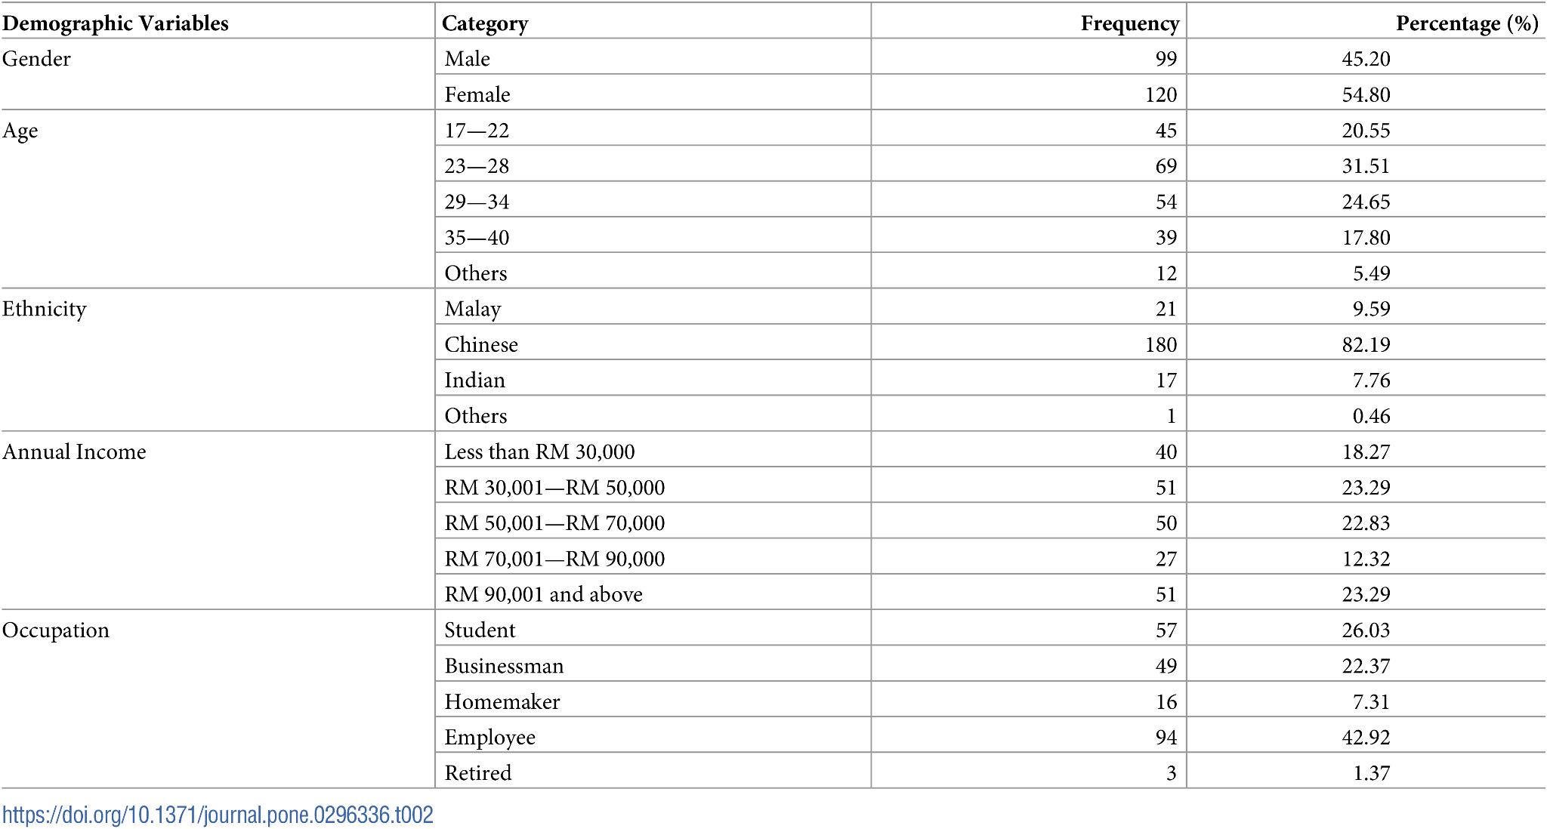
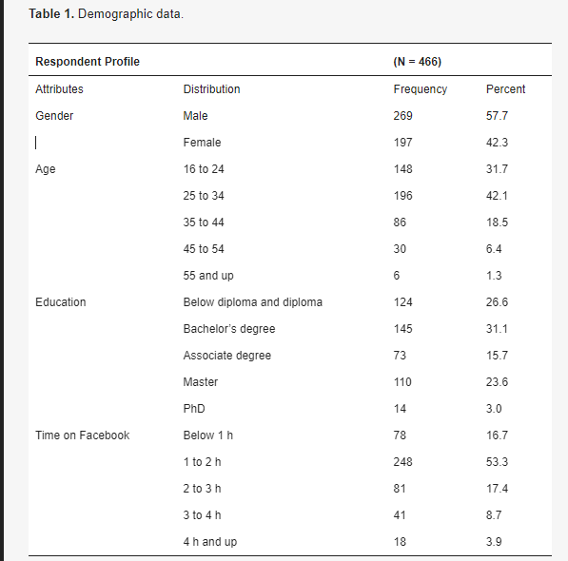
Paper 02 Demographic Data
Paper 01 Demographic Data

Slide 6
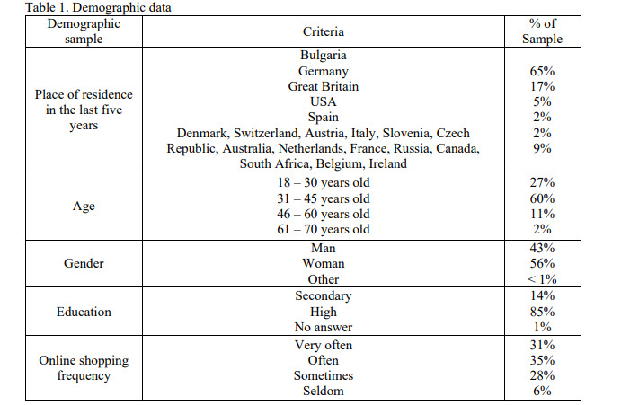
Paper 03 Demographic Data

Slide 7
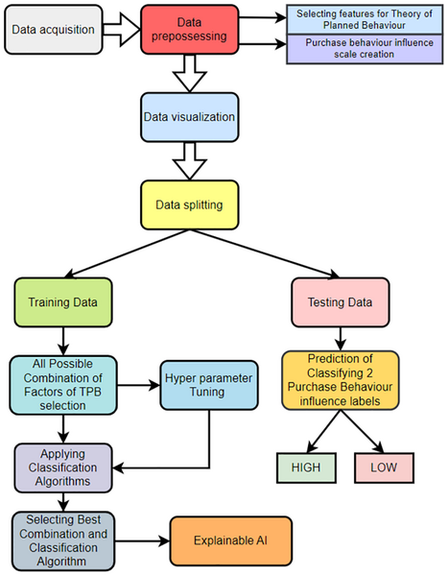
Flowchart: Paper 1

Slide 8
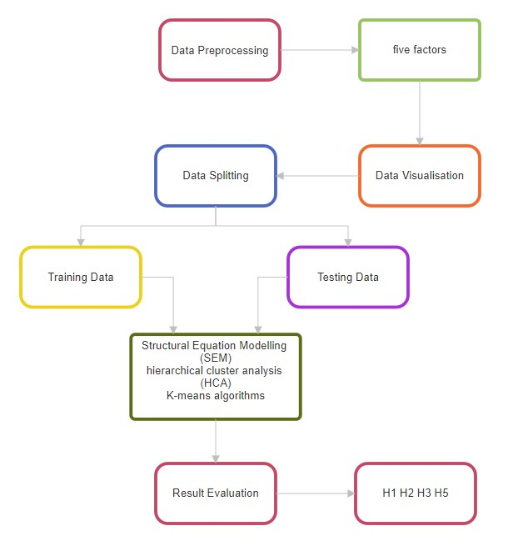
Flowchart: Paper 2

Slide 9
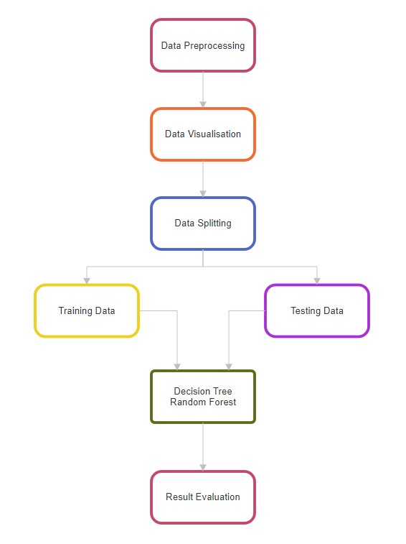
Flowchart: Paper 3

Slide 10
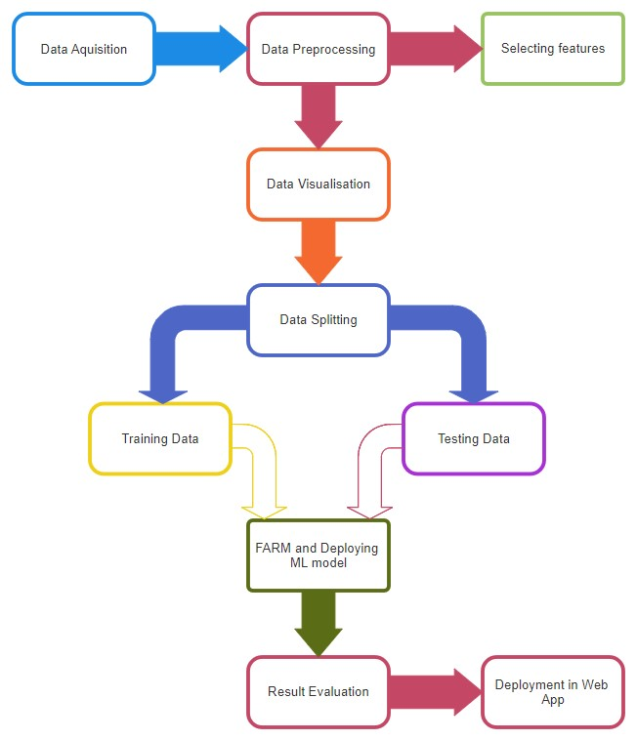
Flowchart: Our Paper

Slide 11
Models
Paper 01 | Paper 02 | Paper 03
K-nearest neighbour (KNN) Decision Tree Random Forest Logistic Regression Naive Bayes Support Vector Machine AdaBoost Gradient Boosting | Structural Equation Modelling (SEM) Hierarchical cluster analysis (HCA) K-means algorithms | Decision Tree Random Forest

Slide 12
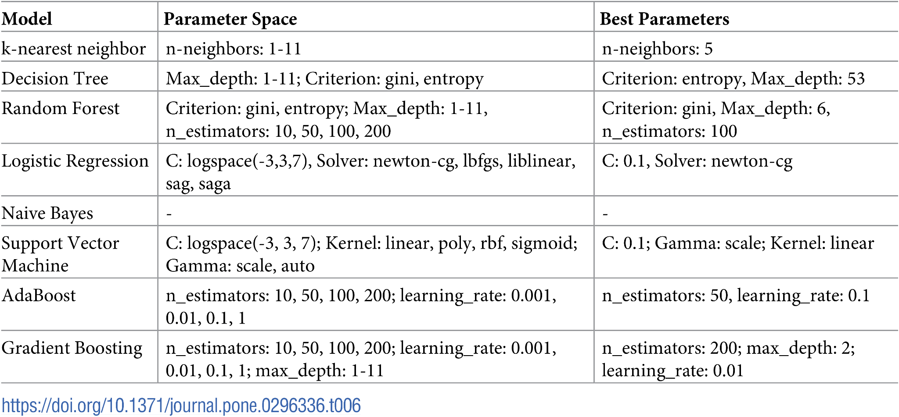
Results Paper 1
Table: Parameter space and best parameters of models.

Slide 13
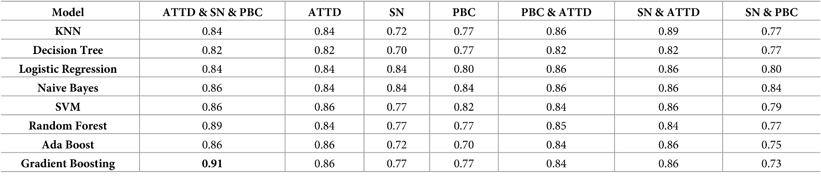

Results Paper 1
Table: Accuracy table of purchase behaviour (PB) on all possible combinations.
Table: Macro F1 scores on all possible combinations.

Slide 14
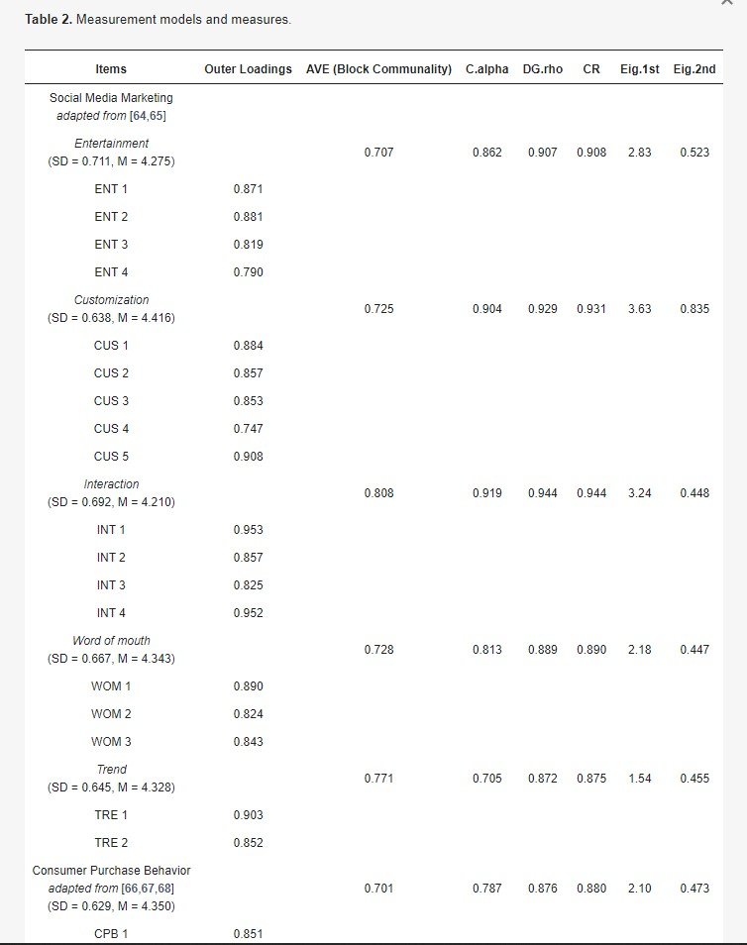
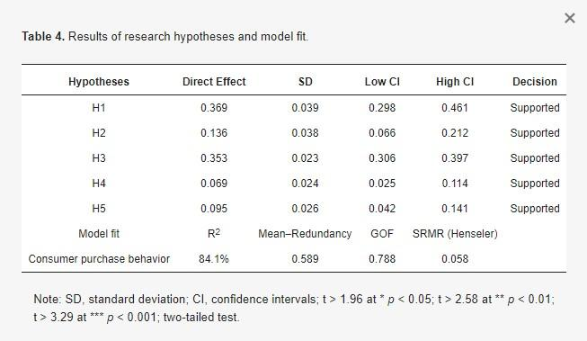
Results Paper 2
Table: Measurement models and measures.
Table: Results of research hypotheses and model fit.

Slide 15
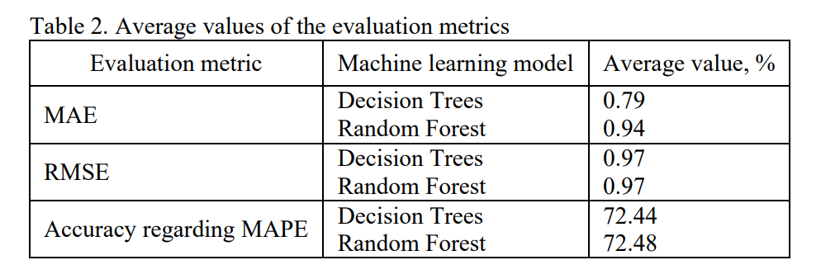
Results Paper 3

Slide 16

UNIQUE CONTRIBUTION - COMPARISON
Paper 01 | Paper 02 | Paper 03 | Our Paper
A total of eight machine learning algorithms were utilized to assess the predictive capabilities of seven combinations of the theory of planned behaviour factors (attitude, social norms, perceived behavioural control) in determining purchase behaviour. Explainable AI (XAI) tool was employed on the best machine learning model to elucidate the black box model which in turn provides a deeper understanding to key factors contributing towards purchasing behaviour. The Explainable AI analysis highlights the significant role of variables like ATTD1, ATTD3, and PBC4 in determining the LOW class, indicating that individuals with lower Likert scores on these factors have reduced motivation to make online purchases. | This study tested five factors that is entertainment, customization, interaction, word of mouth and trend of social networks that are capable of influencing consumer purchase behaviour with evidence from Facebook Marketplace in Hungary This paper’s findings indicate that all five of their hypotheses are supported and confirmed. | Development of a Conceptual Framework helps scholars and industry experts analyze and interpret consumer behavior in a systematic manner. Employment of the Ten-Item Personality Inventory (TIPI) Test. Revealing correlations between personality traits and preferences for e-commerce website functionalities. Suggesting personalized user interfaces to enhance online shopping experiences. Providing detailed insights into how specific personality traits impact purchasing decisions. Evaluating forecast accuracy using Mean Absolute Percentage Error (MAPE), adding quantitative rigor to the findings. | Our project provides a unique blend of Market Basket Analysis and Network Analysis to deeply understand consumer behavior and shopping habits. By integrating detailed customer profiles, product insights, and engagement metrics, we offer actionable insights for targeted marketing campaigns, optimized product offerings, and enhanced customer experience. Our interactive web application facilitates easy access to key findings, empowering businesses to make informed decisions and drive sales growth by identifying patterns, influencers, and associations to optimize marketing strategies, improve product recommendations, and enhance the overall shopping experience.

Slide 17
Thank You!

